Slide 2
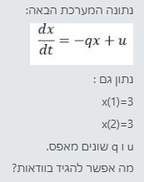

Slide 3
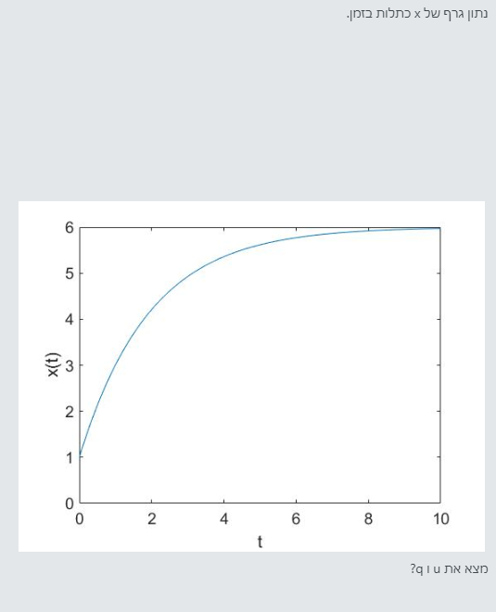

Slide 6
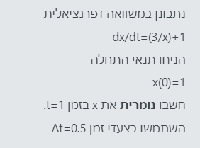

Slide 8
# Define the time of simulation
maxTime <- 5 # 5 hours
dt <- 0.1 # Precision of simulation
# Prepare variable for results of simulation
ts <- seq(0,maxTime,dt)
N <- length(ts) # Number of samples
x <- numeric( N ) # The results will go here
# Run the simulation
x[1] <- 0.2 # Initial condition
for( i in 2:N ) {
x[i] <- x[i-1] + dt*( -2 * x[i-1] + 1 )
}
# Plot the results
plot( ts, x, xlab = "Time (hours)", ylab = "Concentration (x)" )

Slide 9
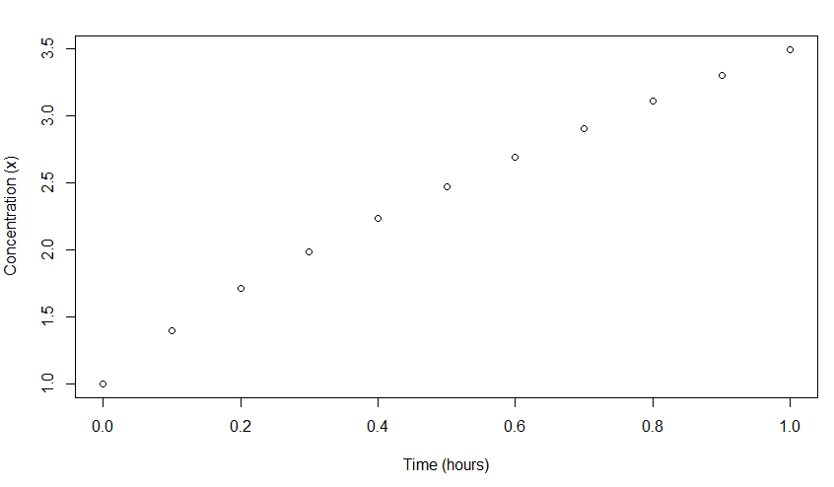

Slide 11
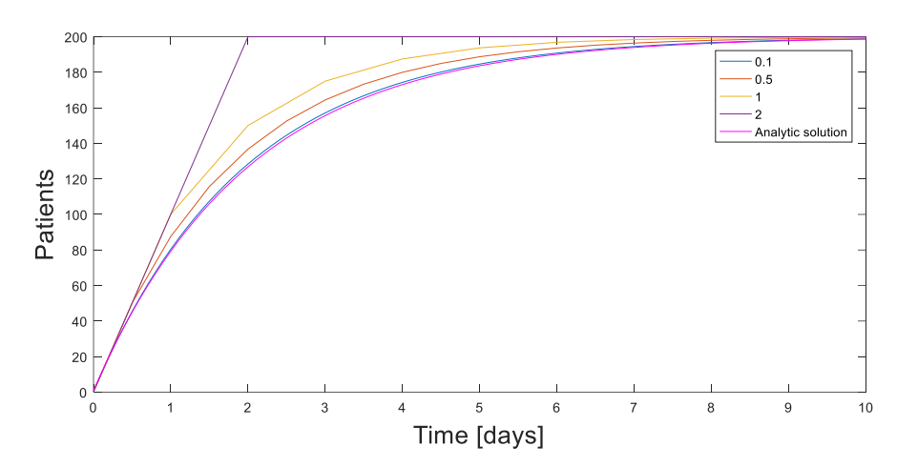

Slide 12
